Slide 1
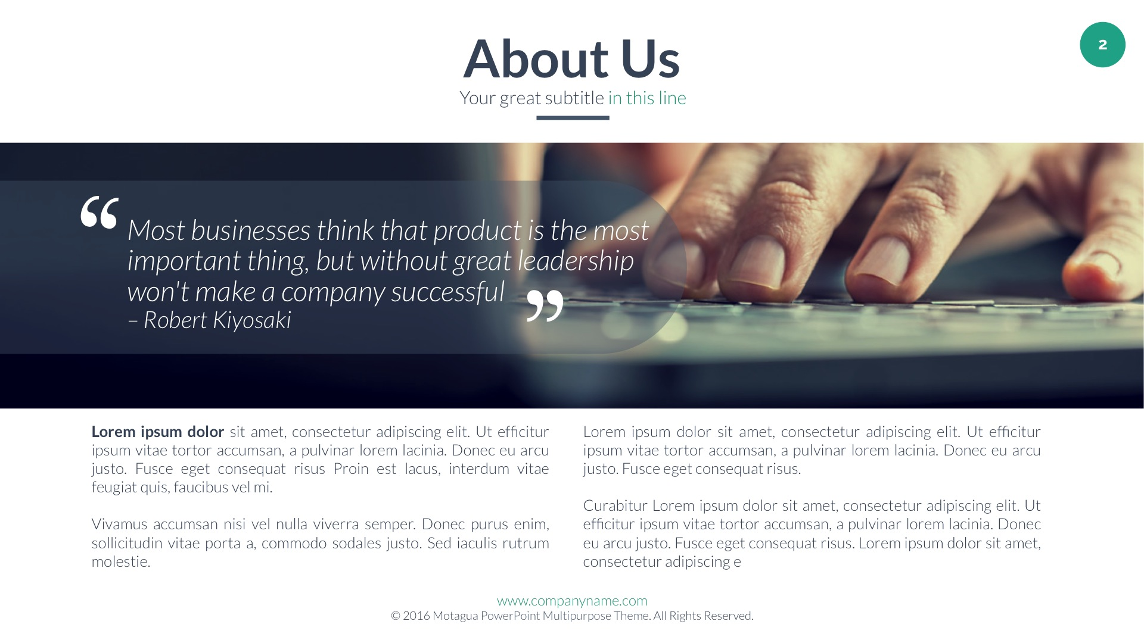

Slide 2

About Us
Your great subtitle in this line
‘
‘
‘
‘
You can be vulnerable without being pathetic. Don’t pretend to feel nothing. We’re lucky we have the ability to feel things so strongly.
– Flower Face
There was an age when people left their houses in their best attire and said hello to all they passed on the way to work, when a meeting meant meeting, and when a call meant paying someone a visit rather than using the phone. While our transactions span the globe today, making such tangible connection more infrequent, it is still key to treat others in the same spirit you would if they were before you.
– How to Win Friends and Influence People in the Digital Age, pp. 123
We frequently hear critiques of the world’s leaders. It’s easy, as the saying goes, to sit in the stands and solve everyone else’s problems. What we rarely witness are people who say, “I can’t imagine the pressure you must be under to have the weight of an entire country on your shoulders. I can’t imagine how much you must lie awake at night thinking through whether you made the right decision or said the right thing on national television.”
– How to Win Friends and Influence People in the Digital Age, pp. 137

